Slide 1
Computer Organization and Architecture
Lecture 22 Caches
Jihe Wang
wangjihe@nwpu.edu.cn

Slide 2
The Big Picture: Where are We Now?
0
The Five Classic Components of a Computer
Today’s Topics:
Recap last lecture
Simple caching techniques
Many ways to improve cache performance
Virtual memory?
Processor
Input
Control
Memory
Datapath
Output

Slide 3
Today’s Topic
00
01. The Problems in Memory
02. Locality and Cache
03. Memory Hierarchy
04. Cache Details
05. Performance Analysis

Slide 4
Memory Gap
1.1

Slide 5
Ideal Memory
1.2
Zero access time (latency)
Infinite capacity
Zero cost
Infinite bandwidth (to support multiple accesses in parallel)

Slide 6
Memory Access Latency VS processor cycle
1.3
Memory delay vs. cycle time vs. average stages.

Slide 7
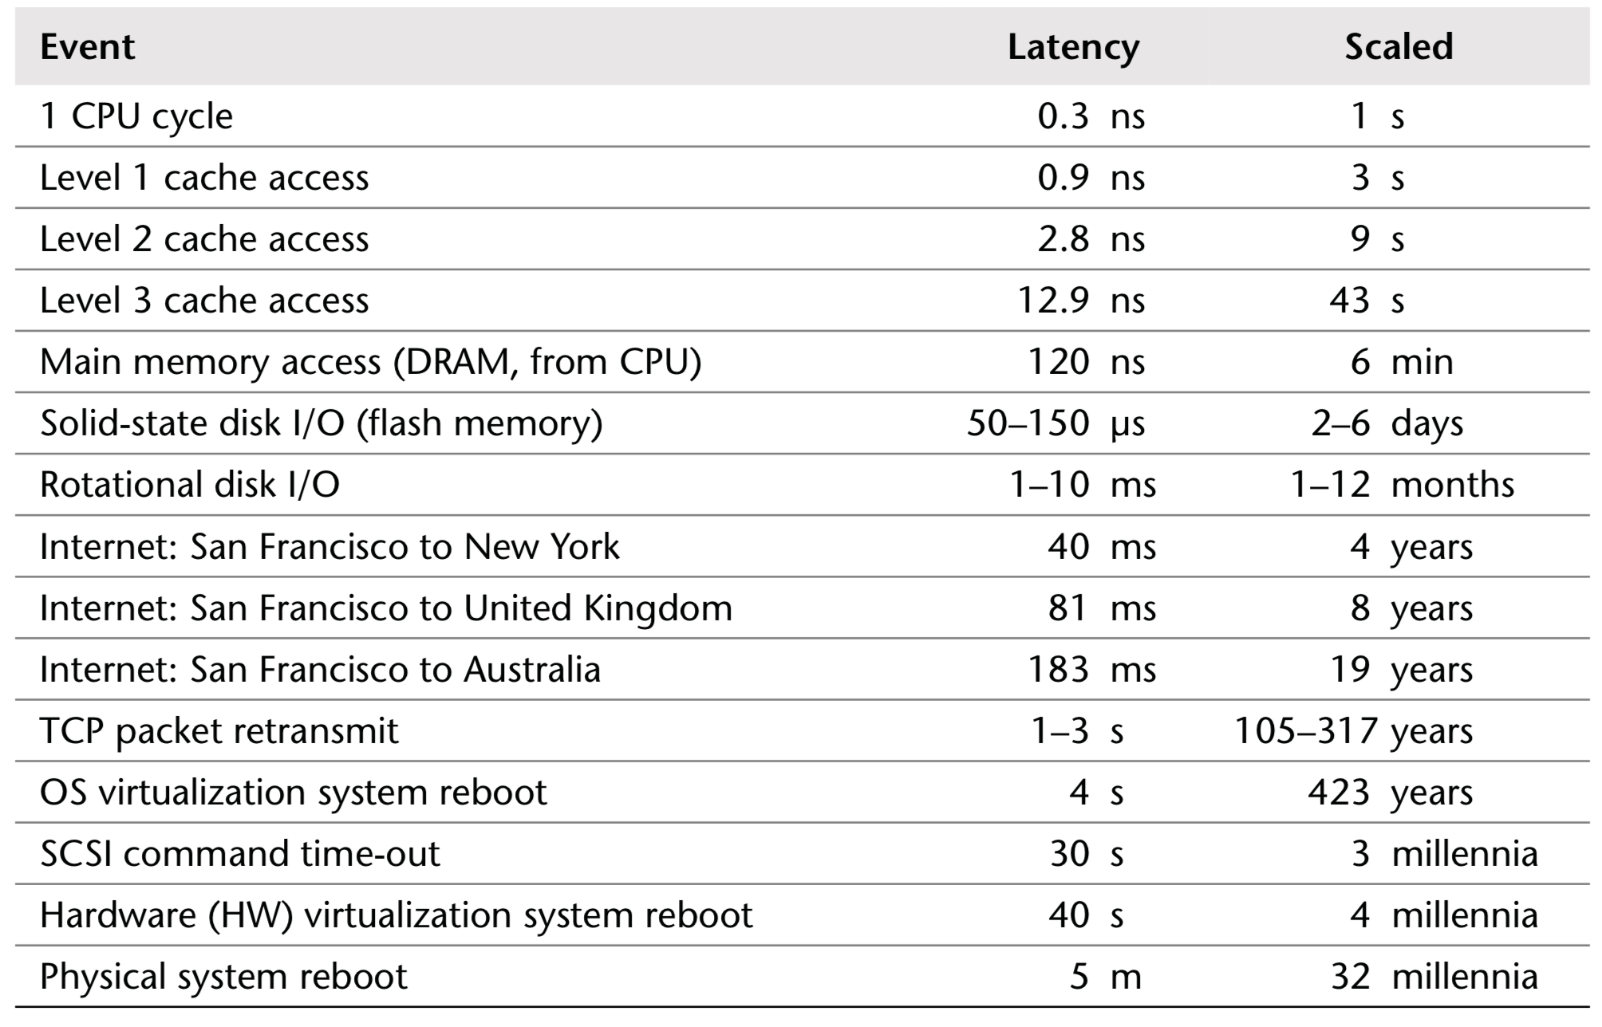
Example Time Scale of System Latencies
1.3

Slide 8
The Problems in Memory
1.4
Bigger is slower
SRAM, 512 Bytes, sub-nanosec
SRAM, KByte~MByte, ~nanosec
DRAM, Gigabyte, ~50 nanosec
Hard Disk, Terabyte, ~10 millisec
Faster is more expensive (dollars and chip area)
SRAM, < 10$ per Megabyte
DRAM, < 1$ per Megabyte
Hard Disk < 1$ per Gigabyte
These sample values scale with time
Other technologies have their place as well
Flash memory, PC-RAM, MRAM, RRAM (not mature yet)

Slide 9
Today’s Topic
00
01. The Problems in Memory
02. Locality and Cache
03. Memory Hierarchy
04. Cache Details
05. Performance Analysis

Slide 10
Locality
2
One’s recent past is a very good predictor of his/her near future.
Temporal Locality: If you just did something, it is very likely that you will do the same thing again soon
since you are here today, there is a good chance you will be here again and again regularly
Spatial Locality: If you did something, it is very likely you will do something similar/related (in space)
every time I find you in this room, you are probably sitting close to the same people

Slide 11
Memory Locality
2.1
A “typical” program has a lot of locality in memory references
typical programs are composed of “loops”
Temporal: A program tends to reference the same memory location many times and all within a small window of time
Spatial: A program tends to reference a cluster of memory locations at a time
most notable examples:
1. instruction memory references
2. array/data structure references
A loop example.

Slide 12
Memory Locality
2.1

Slide 13
Caching Basics: Exploit Temporal Locality
2.2
Idea: Store recently accessed data in automatically managed fast memory (called cache)
Anticipation: the data will be accessed again soon
Temporal locality principle
Recently accessed data will be again accessed in the near future
This is what Maurice Wilkes had in mind:
Wilkes, “Slave Memories and Dynamic Storage Allocation,” IEEE Trans. On Electronic Computers, 1965.
“The use is discussed of a fast core memory of, say 32000 words as a slave to a slower core memory of, say, one million words in such a way that in practical cases the effective access time is nearer that of the fast memory than that of the slow memory.”

Slide 14
Caching Basics: Exploit Spatial Locality
2.3
Idea: Store addresses adjacent to the recently accessed one in automatically managed fast memory
Logically divide memory into equal size blocks (disk->mem.)
Fetch to cache the accessed block in its entirety (mem.->cache)
Anticipation: nearby data will be accessed soon
Spatial locality principle
Nearby data in memory will be accessed in the near future
E.g., sequential instruction access, array traversal

Slide 15
The Bookshelf Analogy
2.4
Book in your hand
Desk
Bookshelf
Boxes at home
Boxes in storage
Recently-used books tend to stay on desk (when to swap/how to pick?)
Comp Arch books, books for classes you are currently taking
Until the desk gets full
Adjacent books in the shelf needed around the same time (How to place/layout?)
If I have organized/categorized my books well in the shelf

Slide 16
Caching in a Pipelined Design
2.5
The cache needs to be tightly integrated into the pipeline
Ideally, access in 1-cycle so that dependent operations do not stall
High frequency pipeline → Cannot make the cache large
But, we want a large cache AND a pipelined design
Idea: Cache hierarchy
Main
Memory
(DRAM)
Level 2
Cache
CPU
Level1
Cache
RF

Slide 17
A Note on Manual vs. Automatic Management
2.6
Manual: Programmer manages data movement across levels
-- too painful for programmers on substantial programs (volatile)
“core” vs “off-chip” memory in the 50’s
still done in some embedded processors (on-chip scratch pad SRAM in a cache)
Automatic: Hardware manages data movement across levels, transparently to the programmer
++ programmer’s life is easier
the average programmer doesn’t need to know about it
You don’t need to know how big the cache is and how it works to write a “correct” program! (What if you want a “fast” program?)

Slide 18
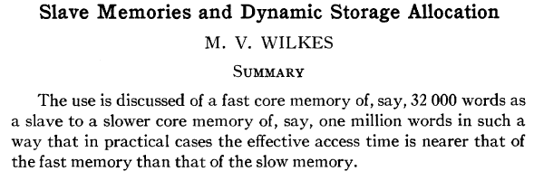
Automatic Management in Memory Hierarchy
2.7
Wilkes, “Slave Memories and Dynamic Storage Allocation,” IEEE Trans. On Electronic Computers, 1965.
“By a slave memory I mean one which automatically accumulates to itself words that come from a slower main memory, and keeps them available for subsequent use without it being necessary for the penalty of main memory access to be incurred again.”

Slide 19
Today’s Topic
00
01. The Problems in Memory
02. Locality and Cache
03. Memory Hierarchy
04. Cache Details
05. Performance Analysis

Slide 20
A Modern Memory Hierarchy
3
Register File
32 words, sub-nsec
L1 cache
~32 KB, ~nsec
L2 cache
512 KB ~ 1MB, many nsec
L3 cache,
.....
Main memory (DRAM),
GB, ~100 nsec
Swap Disk
100 GB, ~10 msec
manual/compiler
register spilling
Memory
Abstraction
Automatic
HW cache
management
automatic
demand
paging
20

Slide 21
Hierarchical Latency Analysis
3.1
For a given memory hierarchy level i it has a technology-intrinsic access time of t_{i,} The perceived access time T_{i} is longer than t_{i}
Except for the outer-most hierarchy, when looking for a given address there is
a chance (hit-rate h_{i}) you “hit” and access time is t_{i}
a chance (miss-rate m_{i}) you “miss” and access time t_{i} +T_{i+1}
h_{i} + m_{i} = 1
Thus
T_{i} = h_{i}·t_{i} + m_{i}·(t_{i} + T_{i+1})
T_{i} = t_{i} + m_{i} ·T_{i+1}
h_{i} and m_{i} are defined to be the hit-rate
and miss-rate of just the references that missed at L_{i-1}
21

Slide 22
Hierarchy Design Considerations
3.2
Recursive latency equation
T_{i} = t_{i} + m_{i} ·T_{i+1}
The goal: achieve desired T₁ within allowed cost
T_{i} ≈ t_{i} is desirable
Keep m_{i} low
increasing capacity C_{i} lowers m_{i}, but beware of increasing t_{i}
lower m_{i} by smarter management (replacement::anticipate what you don’t need, prefetching::anticipate what you will need)
Keep T_{i+1} low
faster lower hierarchies, but beware of increasing cost
introduce intermediate hierarchies as a compromise

Slide 23
Intel Pentium 4 Example
3.3
90nm P4, 3.6 GHz
L1 D-cache
C₁ = 16K
t₁ = 4 cyc int / 9 cycle fp
L2 D-cache
C₂ =1024 KB
t₂ = 18 cyc int / 18 cyc fp
Main memory
t₃ = ~ 50ns or 180 cyc
Notice
best case latency is not 1
worst case access latencies are into 500+ cycles
if m₁=0.1, m₂=0.1
T₁=7.6, T₂=36
if m₁=0.01, m₂=0.01
T₁=4.2, T₂=19.8
if m₁=0.05, m₂=0.01
T₁=5.00, T₂=19.8
if m₁=0.01, m₂=0.50
T₁=5.08, T₂=108

Slide 24
Intel Pentium 4 Example
3.3
90nm P4, 3.6 GHz
L1 D-cache
C₁ = 16K
t₁ = 4 cyc
L2 D-cache
C₂ =1024 KB
t₂ = 18 cyc
Main memory
t₃ = 180 cyc
Notice
best case latency is not 1
worst case access latencies are into 500+ cycles
if m_{L1}=0.1, m_{L2}=0.1
T₁=7.6, T₂=36, T_{M}=180
if m_{L1}=0.01, m_{L2}=0.01
T₁=?, T₂=?, T_{M}=180
if m_{L1}=0.05, m_{L2}=0.01
T₁=?, T₂=?, T_{M}=180
if m_{L1}=0.01, m_{L2}=0.50
T₁=?, T₂=?, T_{M}=180

Slide 25
Intel Pentium 4 Example
3.3
90nm P4, 3.6 GHz
L1 D-cache
C₁ = 16K
t₁ = 4 cyc
L2 D-cache
C₂ =1024 KB
t₂ = 18 cyc
Main memory
t₃ = 180 cyc
Notice
best case latency is not 1
worst case access latencies are into 500+ cycles
if m₁=0.1, m₂=0.1
T₁=7.6, T₂=36, , T_{M}=180
if m₁=0.01, m₂=0.01
T₁=4.2, T₂=19.8, , T_{M}=180
if m₁=0.05, m₂=0.01
T₁=5.00, T₂=19.8, , T_{M}=180
if m₁=0.01, m₂=0.50
T₁=5.08, T₂=108, , T_{M}=180

Slide 26
Today’s Topic
00
01. The Problems in Memory
02. Locality and Cache
03. Memory Hierarchy
04. Cache Details
05. Performance Analysis

Slide 27
Cache
4
Generically, any structure that “memoizes” frequently used results to avoid repeating the long-latency operations required to reproduce the results from scratch, e.g. a web cache
Most commonly in the on-die context: an automatically-managed memory hierarchy based on SRAM
memoize in SRAM the most frequently accessed DRAM memory locations to avoid repeatedly paying for the DRAM access latency

Slide 28
Caching Basics
4.1
Block (line): Unit of storage in the cache
Memory is logically divided into cache blocks that map to locations in the cache
When data referenced
HIT: If in cache, use cached data instead of accessing memory
MISS: If not in cache, bring block into cache
Maybe have to kick something else out to do it
Some important cache design decisions
Placement: where and how to place/find a block in cache?
Replacement: what data to remove to make room in cache?
Granularity of management: large, small, uniform blocks?
Write policy: what do we do about writes?
Instructions/data: Do we treat them separately?

Slide 29
Cache Abstraction and Metrics
4.2
Cache hit rate = (# hits) / (# hits + # misses) = (# hits) / (# accesses)
Average memory access time (AMAT)
= ( hit-rate * hit-latency ) + ( miss-rate * miss-latency )
Aside: Can reducing AMAT improve performance?
Address
Tag Store
(is the address
in the cache?
+ bookkeeping)
Data Store
Hit/miss?
Data

Slide 30
Blocks and Addressing the Cache
4.3
Memory is logically divided into fixed-size blocks
Each block maps to a location in the cache, determined by the index bits in the address
used to index into the tag and data stores
Cache access:
1) index into the tag and data stores with index bits in address
2) check valid bit in tag store
3) compare tag bits in address with the stored tag in tag store
If a block is in the cache, the stored tag should be valid and match the tag of the block
tag
index
byte in block
2b
3 bits
3 bits
8-bit address

Slide 31
Direct-Mapped Cache: Placement and Access
4.4
Assume byte-addressable memory:
256 bytes, 8-byte blocks → 32 blocks
Assume cache: 64 bytes, 8 blocks
Direct-mapped: A block can go to only one location
Addresses with same index contend for the same location
Cause conflict misses
tag
index
byte in block
2b
3 bits
3 bits
Tag store
Data store
Address
V
tag
=?
MUX
byte in block
Hit?
Data

Slide 32
Direct-Mapped Caches
4.4
Direct-mapped cache: Two blocks in memory that map to the same index in the cache cannot be present in the cache at the same time
One index → one entry
Can lead to 0% hit rate if more than one block accessed in an interleaved manner map to the same index
Assume addresses A and B have the same index bits but different tag bits
A, B, A, B, A, B, A, B, … → conflict in the cache index
All accesses are conflict misses

Slide 33
Set Associativity
4.5
Addresses 0 and 8 always conflict in direct mapped cache
Instead of having one column of 8, have 2 columns of 4 blocks
Tag store
Data store
SET
V
tag
V
tag
=?
=?
MUX
Logic
MUX
byte in block
Address
Hit?
tag
index
byte in block
Key idea: Associative memory within the set
+ Accommodates conflicts better (fewer conflict misses)
-- More complex, slower access, larger tag store
3b
2 bits
3 bits

Slide 34
Higher Associativity
4.6
4-way
+ Likelihood of conflict misses even lower
-- More tag comparators and wider data mux; larger tags
Tag store
=?
=?
=?
=?
Logic
Hit?
Data store
MUX
MUX
byte in block

Slide 35
Full Associativity
4.7
Fully associative cache
A block can be placed in any cache location
Tag store
=?
=?
=?
=?
=?
=?
=?
=?
Logic
Hit?
Data store
MUX
MUX
byte in block

Slide 36
Associativity (and Tradeoffs)
4.8
Degree of associativity: How many blocks can map to the same index (or set)?
Higher associativity
++ Higher hit rate
-- Slower cache access time (hit latency and data access latency)
-- More expensive hardware (more comparators)
Diminishing returns from higher
associativity
hit rate
associativity

Slide 37
Issues in Set-Associative Caches
4.9
Think of each block in a set having a “priority”
Indicating how important it is to keep the block in the cache
Key issue: How do you determine/adjust block priorities?
There are three key decisions in a set:
Insertion, promotion, eviction (replacement)
Insertion: What happens to priorities on a cache fill?
Where to insert the incoming block, whether or not to insert the block
Promotion: What happens to priorities on a cache hit?
Whether and how to change block priority
Eviction/replacement: What happens to priorities on a cache miss?
Which block to evict and how to adjust priorities

Slide 38
Eviction/Replacement Policy
4.10
Which block in the set to replace on a cache miss?
Any invalid block first
If all are valid, consult the replacement policy
Random
FIFO
Least recently used (how to implement?)
Not most recently used
Least frequently used?
Least costly to re-fetch?
Why would memory accesses have different cost?
Hybrid replacement policies
Optimal replacement policy? (depends on future access)

Slide 39
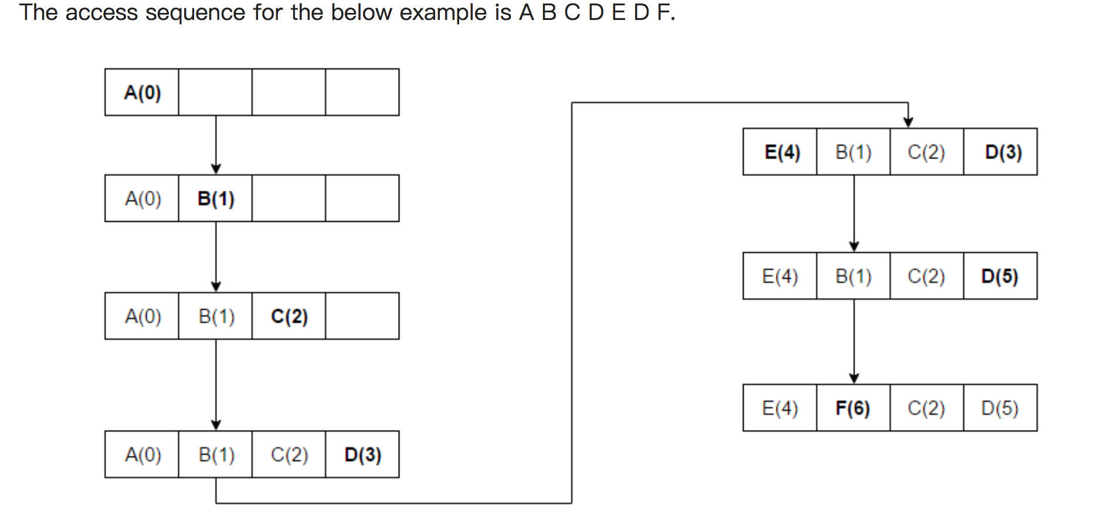
Implementing LRU
4.11

Slide 40
Implementing LRU
4.11
Idea: Evict the least recently accessed block
Problem: Need to keep track of access ordering of blocks
Question: 2-way set associative cache:
What do you need to implement LRU perfectly?
Question: 4-way set associative cache:
What do you need to implement LRU perfectly?
How many different orderings possible for the 4 blocks in the set?
How many bits needed to encode the LRU order of a block?
What is the logic needed to determine the LRU victim?

Slide 41
Approximations of LRU
4.12
Most modern processors do not implement “true LRU” (also called “perfect LRU”) in highly-associative caches
Why?
True LRU is complex
LRU is an approximation to predict locality anyway (i.e., not the best possible cache management policy)
Examples:
Not MRU (not most recently used)
Hierarchical LRU: divide the 4-way set into 2-way “groups”, track the MRU group and the MRU way in each group

Slide 42
What’s In A Tag Store Entry?
4.13
Valid bit
Tag
Replacement policy bits
Dirty bit?
Write back vs. write through caches

Slide 43
Handling Writes
4.14
When do we write the modified data in a cache to the next level?
Write through: At the time the write happens
Write back: When the block is evicted
Write-back
+ Can consolidate multiple writes to the same block before eviction
Potentially saves bandwidth between cache levels + saves energy
-- Need a bit in the tag store indicating the block is “dirty/modified”
Write-through
+ Simpler
+ All levels are up to date. Consistency: Simpler cache coherence because no need to check lower-level caches
-- More bandwidth intensive; no coalescing of writes

Slide 44
Handling Writes (II)
4.14
Do we allocate a cache block on a write miss?
Allocate on write miss: Yes
No-allocate on write miss: No
Allocate on write miss
+ Can consolidate writes instead of writing each of them individually to next level
+ Simpler because write misses can be treated the same way as read misses
-- Requires (?) transfer of the whole cache block
No-allocate
+ Conserves cache space if locality of writes is low (potentially better cache hit rate)

Slide 45
Handling Writes (III)
4.14
What if the processor writes to an entire block over a small amount of time?
Is there any need to bring the block into the cache from memory in the first place?
Ditto for a portion of the block, i.e., subblock
E.g., 4 bytes out of 64 bytes

Slide 46
Instruction vs. Data Caches
4.15
Separate or Unified?
Unified:
+ Dynamic sharing of cache space: no overprovisioning that might happen with static partitioning (i.e., split I and D caches)
-- Instructions and data can thrash each other (i.e., no guaranteed space for either)
-- I and D are accessed in different places in the pipeline. Where do we place the unified cache for fast access?
First level caches are almost always split
Mainly for the last reason above
Second and higher levels are almost always unified

Slide 47
Multi-level Caching in a Pipelined Design
4.16
First-level caches (instruction and data)
Decisions very much affected by cycle time
Small, lower associativity
Tag store and data store accessed in parallel (why?)
Second-level caches
Decisions need to balance hit rate and access latency
Usually large and highly associative; latency not as important
Tag store and data store accessed serially (why?)
Serial vs. Parallel access of levels
Serial: Second level cache accessed only if first-level misses
Second level does not see the same accesses as the first
First level acts as a filter (filters some temporal and spatial locality)
Management policies are therefore different

Slide 48
Today’s Topic
00
01. The Problems in Memory
02. Locality and Cache
03. Memory Hierarchy
04. Cache Details
05. Performance Analysis

Slide 49
Cache Parameters vs. Miss/Hit Rate
5
Cache size
Block size
Associativity
Replacement policy
Insertion/Placement policy

Slide 50
Cache Parameters vs. Miss/Hit Rate
5
Cache size
Block size
Associativity

Slide 51
Cache Size
5.1
Cache size: total data (not including tag) capacity
bigger can exploit temporal locality better
not ALWAYS better
Too large a cache adversely affects hit and miss latency
smaller is faster => bigger is slower
access time may degrade critical path
Too small a cache
doesn’t exploit temporal locality well
useful data replaced often
Working set: the whole set of data the executing application references
Within a time interval
hit rate
“working set”
size
cache size

Slide 52
Block Size
5.2
Block size is the data that is associated with an address tag
not necessarily the unit of transfer between hierarchies
Sub-blocking: A block divided into multiple pieces (each with V bit)
Can improve “write” performance
Too small blocks
don’t exploit spatial locality well
have larger tag overhead
Too large blocks
too few total # of blocks → less
temporal locality exploitation
waste of cache space and bandwidth/energy
if spatial locality is not high
hit rate
block
size
52

Slide 53
Large Blocks: Critical-Word and Subblocking
5.3
Large cache blocks can take a long time to fill into the cache
fill cache line critical word first
restart cache access before complete fill
Large cache blocks can waste bus bandwidth
divide a block into subblocks
associate separate valid bits for each subblock
When is this useful?
subblock
v
d
subblock
v
d
subblock
v
d
tag

Slide 54
Associativity
5.4
How many blocks can map to the same index (or set)?
Larger associativity
lower miss rate, less variation among programs
diminishing returns, higher hit latency
Smaller associativity
lower cost
lower hit latency
Especially important for L1 caches
Power of 2 associativity required?
hit rate
associativity
54

Slide 55
Classification of Cache Misses
5.5
Compulsory miss
first reference to an address (block) always results in a miss
subsequent references should hit unless the cache block is displaced for the reasons below
Capacity miss
cache is too small to hold everything needed
defined as the misses that would occur even in a fully-associative cache (with optimal replacement) of the same capacity
Conflict miss
defined as any miss that is neither a compulsory nor a capacity miss

Slide 56
How to Reduce Each Miss Type
5.6
Compulsory
Caching cannot help
Prefetching
Conflict
More associativity
Other ways to get more associativity without making the cache associative
Victim cache
Hashing
Software hints?
Capacity
Utilize cache space better: keep blocks that will be referenced
Software management: divide working set such that each “phase” fits in cache

Slide 57
Improving Basic Cache Performance
5.7
Reducing miss rate
More associativity
Alternatives/enhancements to associativity
Victim caches, hashing, pseudo-associativity, skewed associativity
Better replacement/insertion policies
Software approaches
Reducing miss latency/cost
Multi-level caches
Critical word first
Subblocking/sectoring
Better replacement/insertion policies
Non-blocking caches (multiple cache misses in parallel)
Multiple accesses per cycle
Software approaches

